Slide 1


The impacts of Covid-19 cases upon real estate sales in Victoria
Jeremy Chia – Anna Nguyen - Matthew Taylor - Kenny Dao

Slide 2
The big question
Have the numbers of Covid-19 cases in the most popular Local Government Area changed their popularity for homeowners?
Hypothesis: High Covid-19 cases in the most popular Local Government Area will reduce their popularity.

Slide 3
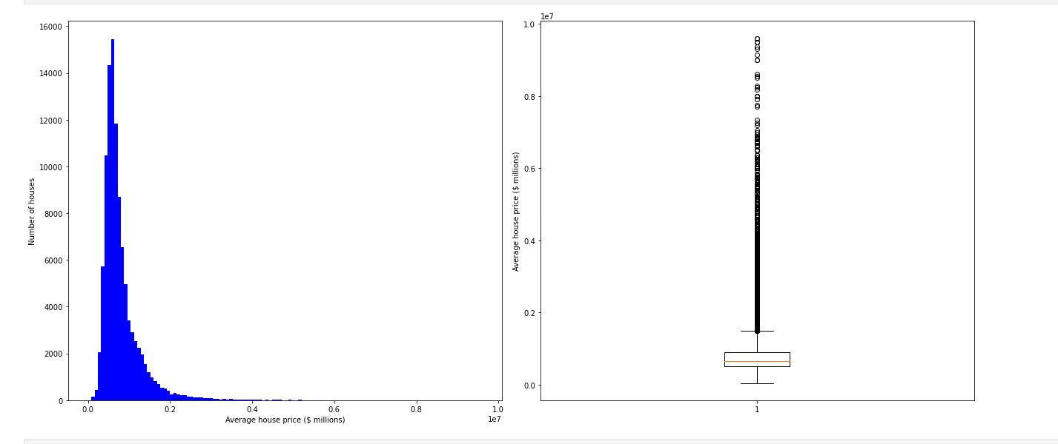
Property Data Distribution [Feb 2018 – Jan 2020]

Slide 4

The working questions
What are the three most popular Local Government Areas in Victoria before March 2020?
Measured by changes to housing price in each LGA
Measured by changes to housing purchase in each LGA
What are the factors that contribute to this popularity?
Does the concentration of schools contribute to its popularity?
Does the concentration of hospitals contribute to its popularity?
How has the popularity of the top 3 LGAs in Victoria changed after March 2020?
Measured by changes to housing price & in each LGA
Measured by changes to housing purchase in each LGA
Does the number of Covid-19 cases from March to June 2020 in each LGA contribute to its popularity?

Slide 5
Data Collection
School data & Hospital data
Victorian Government Data Directory
https://discover.data.vic.gov.au/dataset/school-locations-time-series
https://discover.data.vic.gov.au/dataset/hospital-locations-spatial
Real Estate data
Kaggle
https://www.kaggle.com/htagholdings/aus-real-estate-sales-march-2019-to-april-2020
Covid-19 Data
DHHS Website
https://www.dhhs.vic.gov.au/victorian-coronavirus-covid-19-data

Slide 6
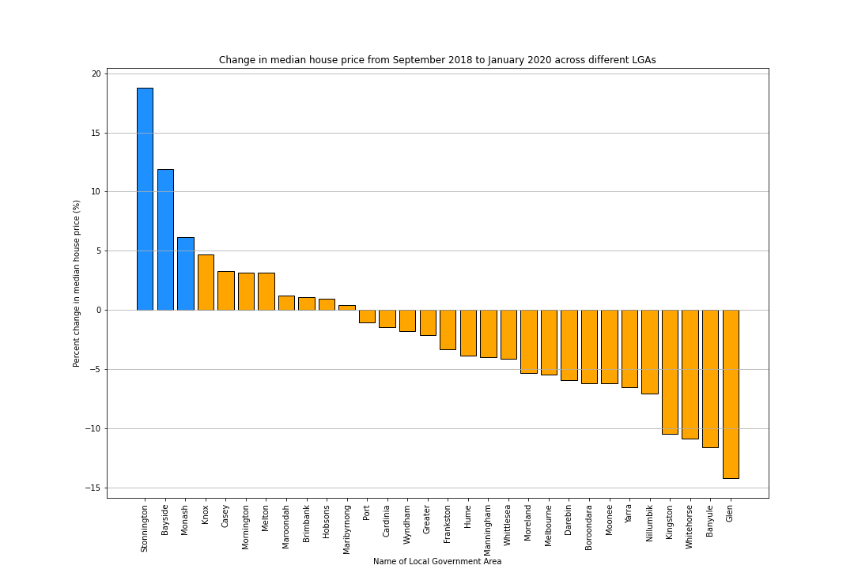
Property Price Analysis (Pre-Covid)

Slide 7
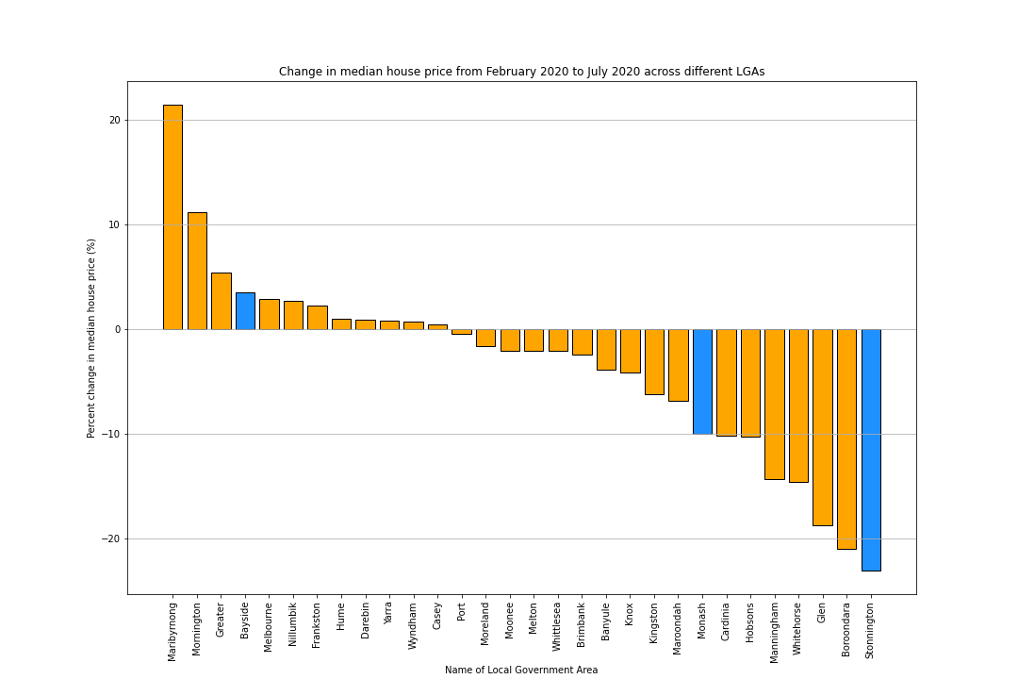
Property Price Analysis (Post-Covid)

Slide 8
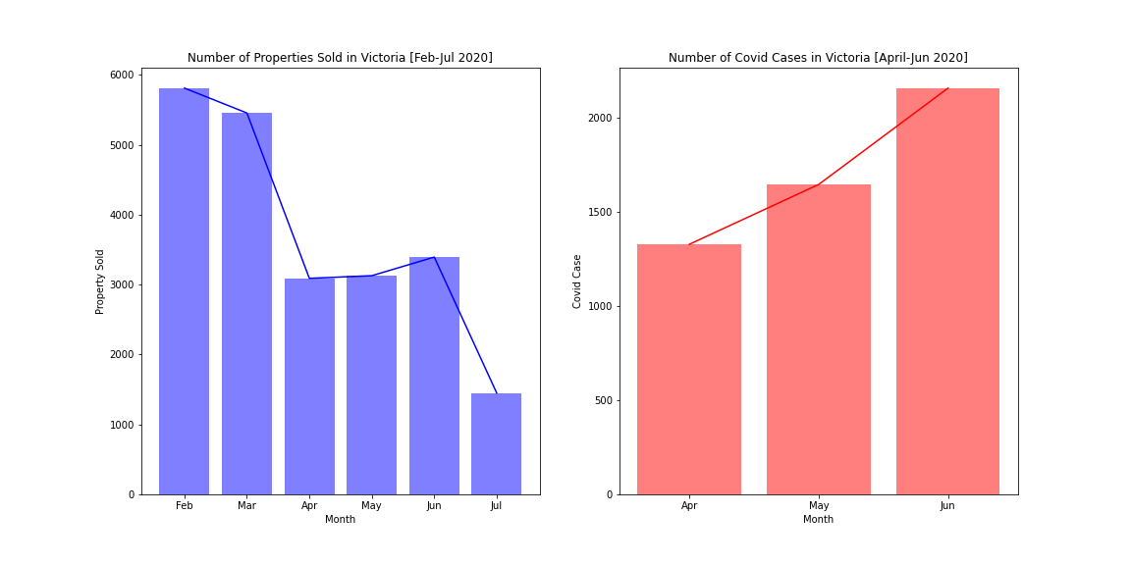
Property Sold During Covid-19 [Feb – Jul 2020]
5,800
2,159
5,600
1,647
1,329
3,000
1,500

Slide 9
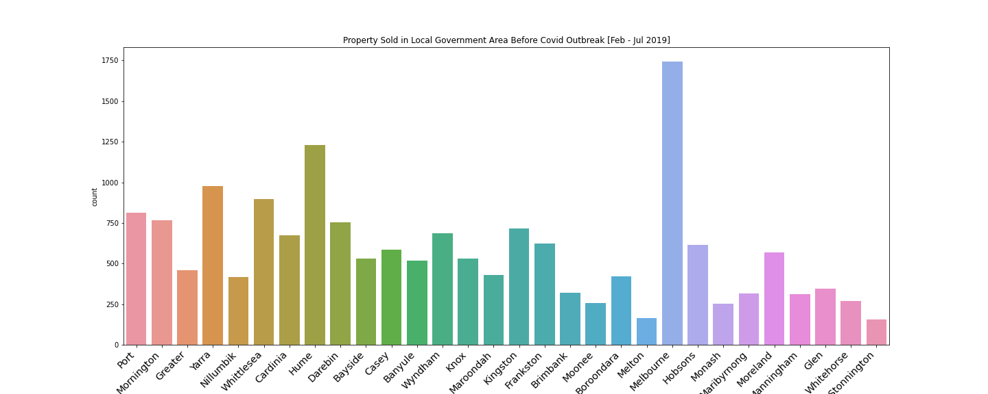
Property Sold By LGA Before Covid-19 Outbreak [Feb – Jul 2019]
1,750
600
300
160

Slide 10
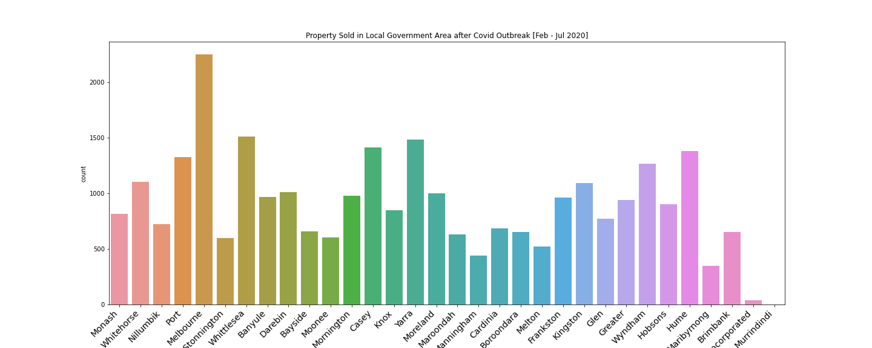
Property Sold By LGA During Covid-19 [Feb – Jul 2020]
2,950
700
600
630

Slide 11
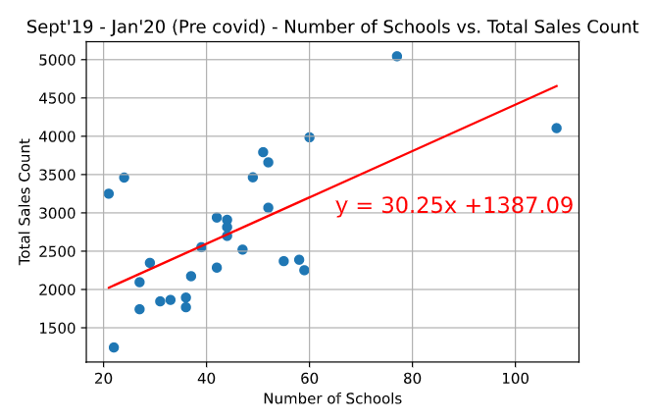
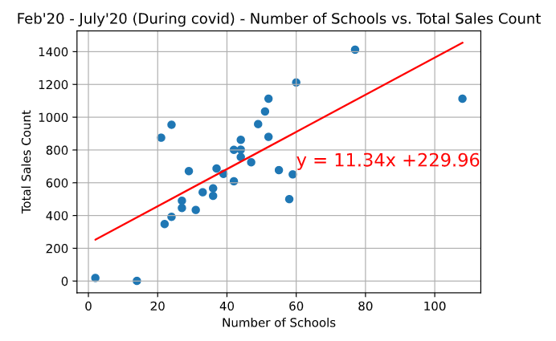
Property Sold [Pre vs During Covid-19]

Slide 12
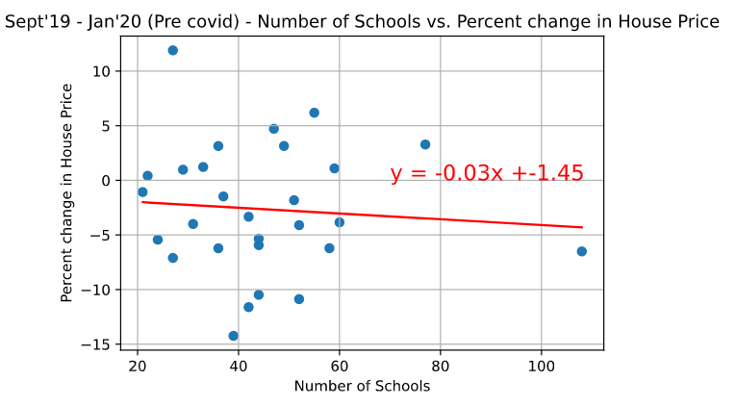
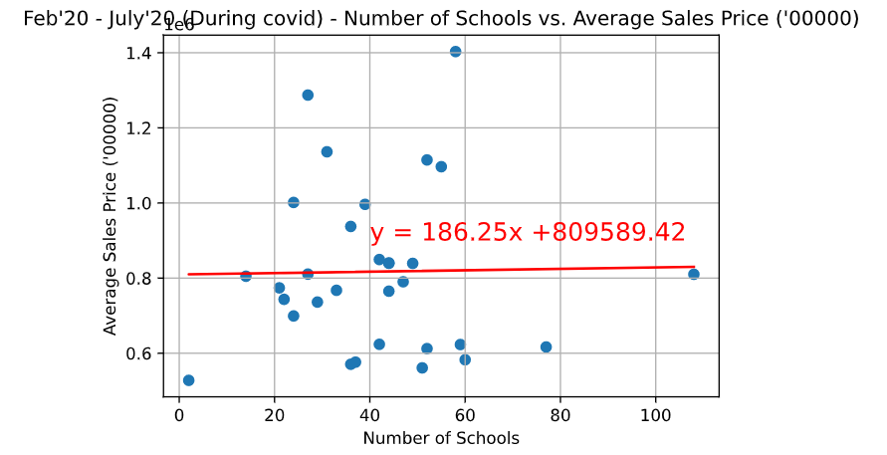
Property Price Change [Pre vs During Covid-19]

Slide 13
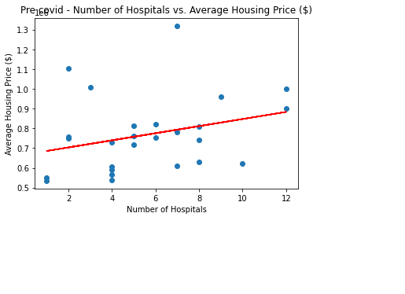
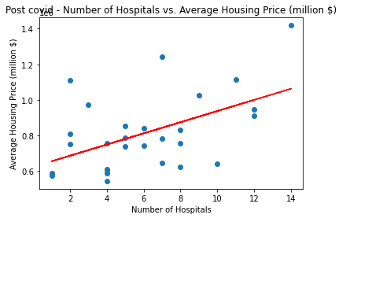
Real-estate Data Before Covid-19
The r-squared is: 0.08410507608477118 The correlation between both factors is 0.29

Slide 14
Findings & Conclusion & Implications
Before Covid (September 2018 – January 2020)
The top 3 LGAs are: Stonnington (1), Bayside (2), Monash (3)
Hospitals: 8% of the house price can be explained by the number of hospitals
Schools: The more schools there are, the higher the total number of sales is in a Local Government area.
After Covid (February – July 2020)
Stonnington: - 23% (Most Covid-cases in April, second most in May until mid June)
Bayside: + 3.6% (Next to Stonnington, with an average number of Covid-cases)
Monash: - 9.9% (Top 5 Covid-cases in early April, top 15 Covid-cases until mid June)

Slide 15
Thank you.

Slide 16
Q & A

